Slide 1


Capstone Project
Hotel Booking Analysis
Pravin Singh
Keshaw Agarwal
Shubham Jindal
Rohun Rajvanshi
Shubham Shahu

Slide 2
The Problem statement
Have you ever wondered when the best time of year to book a hotel room is?
What is the optimal length of stay in order to get the best daily rate?
What if you wanted to predict whether or not a hotel was likely to receive a disproportionately high number of special requests?

Slide 3


Slide 4
Analysis of hotel booking data for the period 2015-2017:-
Data Summary
Summary of descriptive statistics for different hotel types
Time -wise Analysis
Analysis on Cancellation of Hotel Bookings
Distribution Channel wise Analysis
Country wise Analysis
Correlation Heat map
Other Important Factors
Analysis on Average daily rate (ADR)
Conclusion

Slide 5
Data Summary
Data consists the different column wise explanation of following variables described here as:
Hotel: list of different types of hotels
Country: origin country of customer
Distribution Channel: It tells us about the source through which booking was done (Corporate, GDS, Direct, Undefined, TA/TO)
Market Segment: This variable Specifies the purpose of visit of the customers.
Lead Time: time interval between reservation and actual arrival of the customers.
Meal: this variable tells the different types of meals preferred by customers
Deposit Type: it signifies the different types of deposits made by customer.
Customer Type: types of customer (transient, group etc)

Slide 6
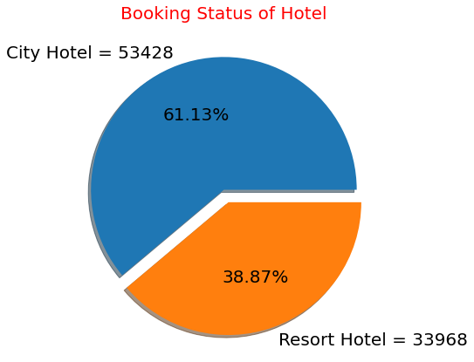
Descriptive Statistics
Approx. 61 percent booking are made for
City Hotel and approx 39 percent bookings
are made for Resort Hotel.
It means customers preferred City hotel more
than the Resort hotel.

Slide 7
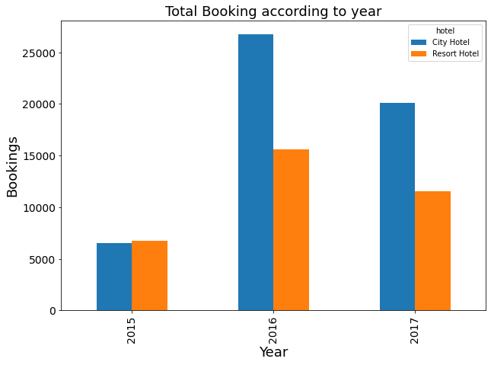
Time-wise Analysis
As we can see in Each Year City Hotel is Getting more bookings as Compared to Resort Hotel Except Year 2015.
In 2015 Resort Hotel has Slightly more Booking than City Hotel.

Slide 8
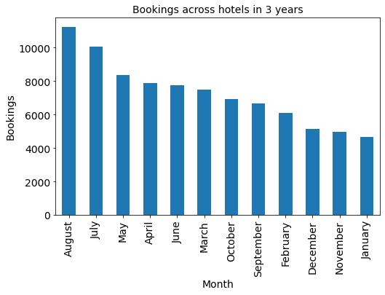
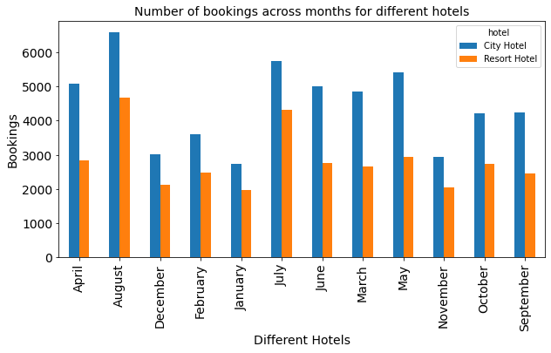
According to our observation, in the three given years, August month is most preferred by customers and January is the least one.

Slide 9
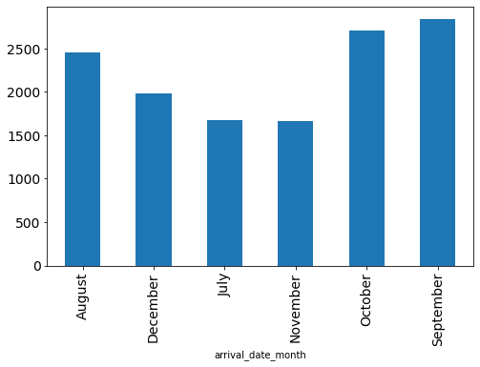
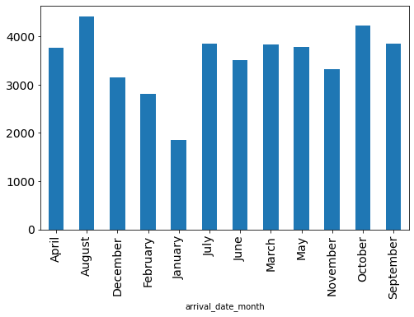
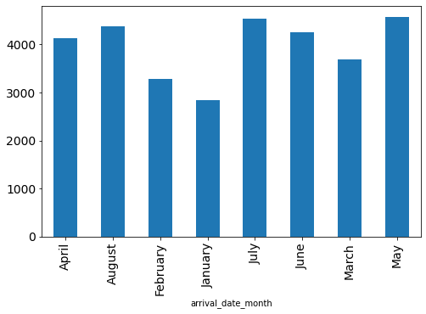
2015
2016
2017
These charts show the number of bookings for both hotels each year
September, August and January are the most preferred months by customers in the years 2015, 2016 and 2017 respectively

Slide 10
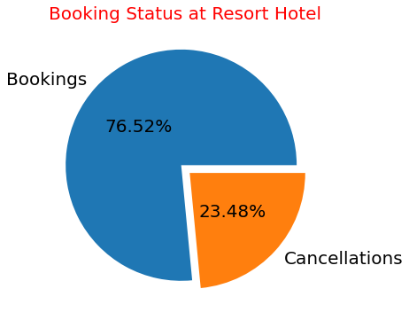
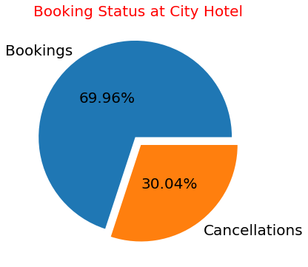
Analysis on Cancellation of Hotel Bookings
City Hotel has almost 30% Booking Cancellation rate.
Resort Hotel has almost 24% Booking Cancellation Rate.

Slide 11
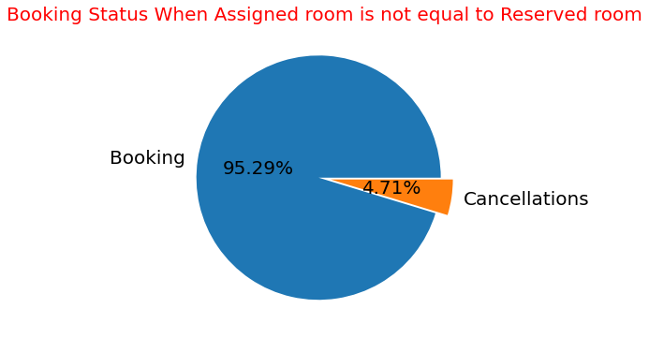
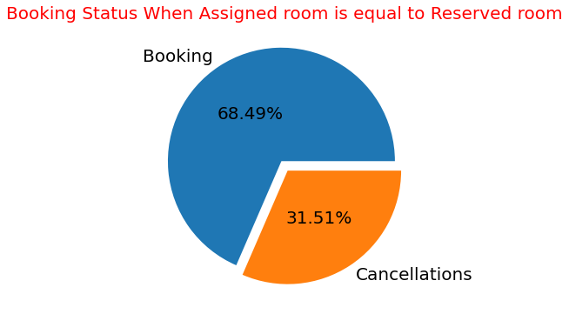
When the Assigned room is not Equal to Reserved Room only 5% of Bookings are Being Cancelled.
When the Assigned room is Equal to Reserved room then more than 31% of the Bookings are Being Cancelled.
So Assigning of Different room from Reserved Room Cannot be the Reason for the Cancellation of Bookings.

Slide 12
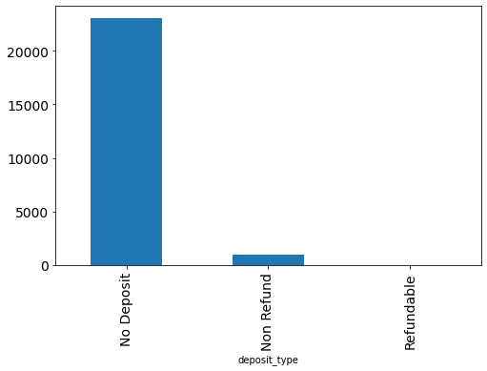
We have Customers with Three Deposit types (No Deposit, Non-Refund , Refundable)
Most of the Bookings are Cancelled where the Deposit type Was No Deposit.
As we know in No Deposit we Need to Pay any Amount to the Hotel in Advance So this can be the Reason for Higher Cancellation of the Bookings.

Slide 13
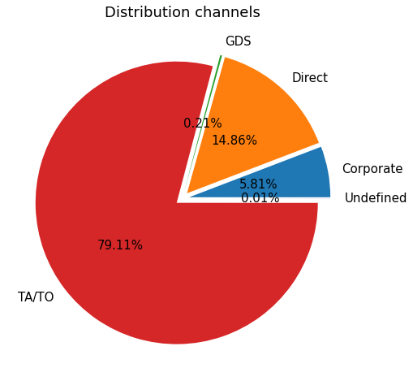
Distribution Channel Analysis
Most Number of Bookings are made through Travel Agent and Tour Operator Channel.
After TA/TO the Most used Channel for Booking is Direct.

Slide 14
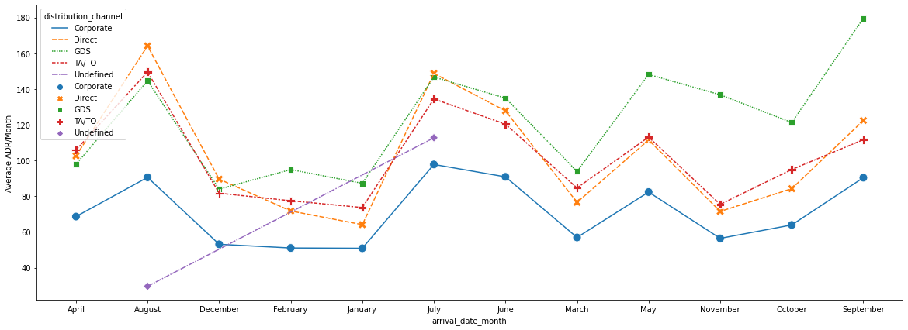
GDS and Direct Channel have Highest ADR across the Whole Year.
It means GDR and Direct are Generating Higher Revenue.

Slide 15
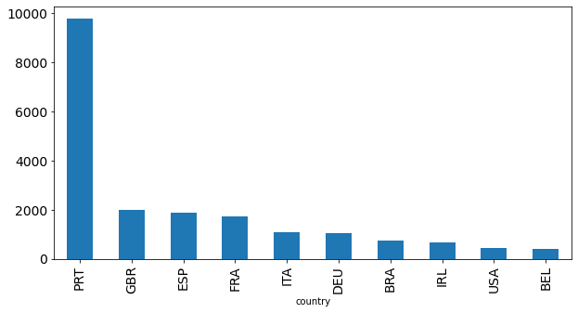
Country Wise Analysis
Guests are Coming from Various Countries but Highest No. of Customers are Coming from Portugal.

Slide 16
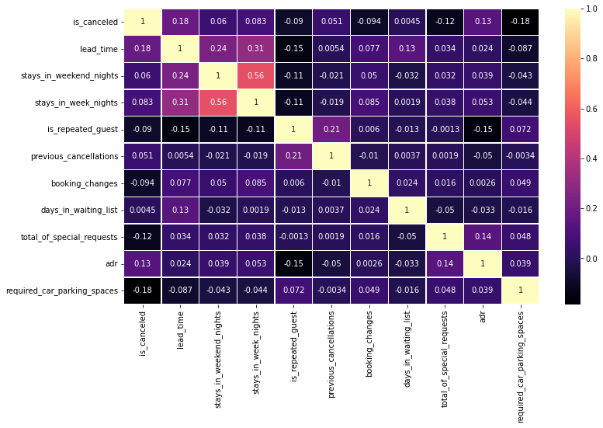
Correlation Heatmap

Slide 17
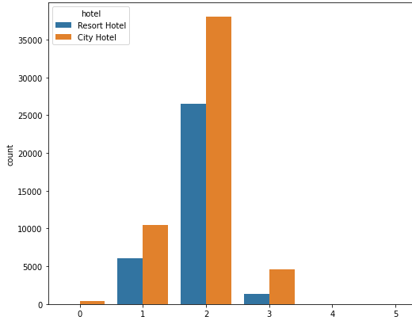
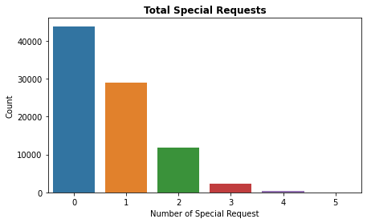
Other Important Factors
Number of Adults
We observe that the most bookings are from 2 adults in both the hotels
Most customers do not make a special request
Adults

Slide 18
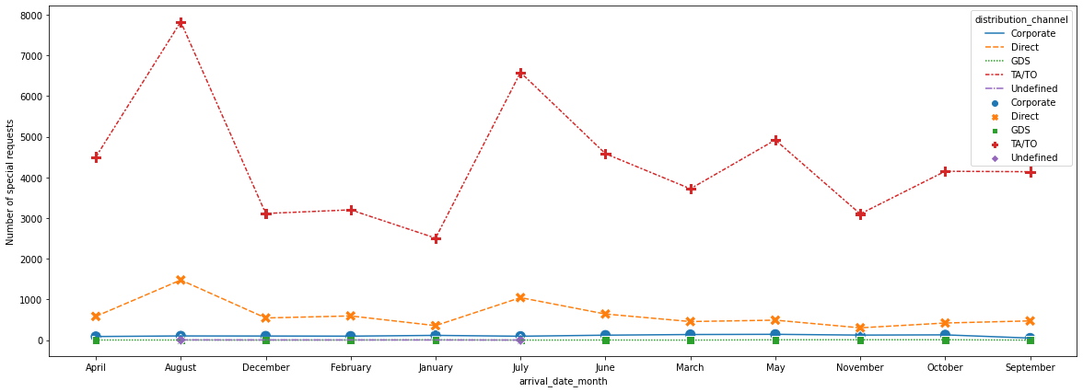
Customers which are coming through TA/TO Channel have Highest number of Special Requests.
No. of Special Request are Higher in July, August and May Because Bookings are also Higher in these Months Only.

Slide 19
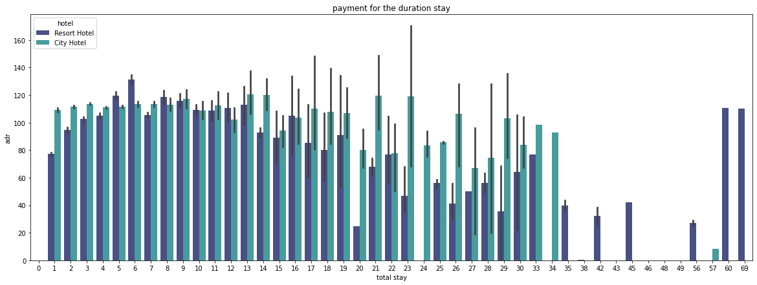
Analysis on Average Daily Rate (ADR)
We observe that with the increasing length of stay we get better adr. In the above chart we can see that we get best adr between the duration of 35 to 57 days.
It has been observed that the adr of city hotel has not fluctuate much as compared to resort hotel.

Slide 20
Conclusion
Both of the Hotels Received Highest no. of Bookings in the Month of August in Each Year
According to the 3 year data, the most preferred month to book a hotel room is August for all customers
Highest No. of Customers are Coming from Europe and Mainly from Portugal
Highest No. of Bookings are Coming from TA/TO Channel
The best average daily rate is observed in resort hotel rather than city hotel when the optimal length of stay increases and also it is observed that the daily rate does not vary much in city hotel.
Cancellation is highest when the customer does not deposit any amount for the booking
Most people prefer to stay at the hotels between 1 to 6 days

Slide 21
Recommendations
Removing No Deposit deposit type from the booking policy of the hotels.
Cancellation is more when the customer does not deposit any amount for the booking.
The hotels should promote distribution channels other than TA/TO.
Majority number of bookings come through TA/TO.
Hotels can offer special discounts to adults coming in groups and are more than 2 in number.
Majority of bookings are by 2 adults.

Slide 22
Challenges
Handling huge chunk of data keeping in mind not to miss anything which is even of little relevance.
Deciding the important factors on which the analysis has to be done.
Confusion between type of graphs to be plotted.

Slide 23


